Slide 1
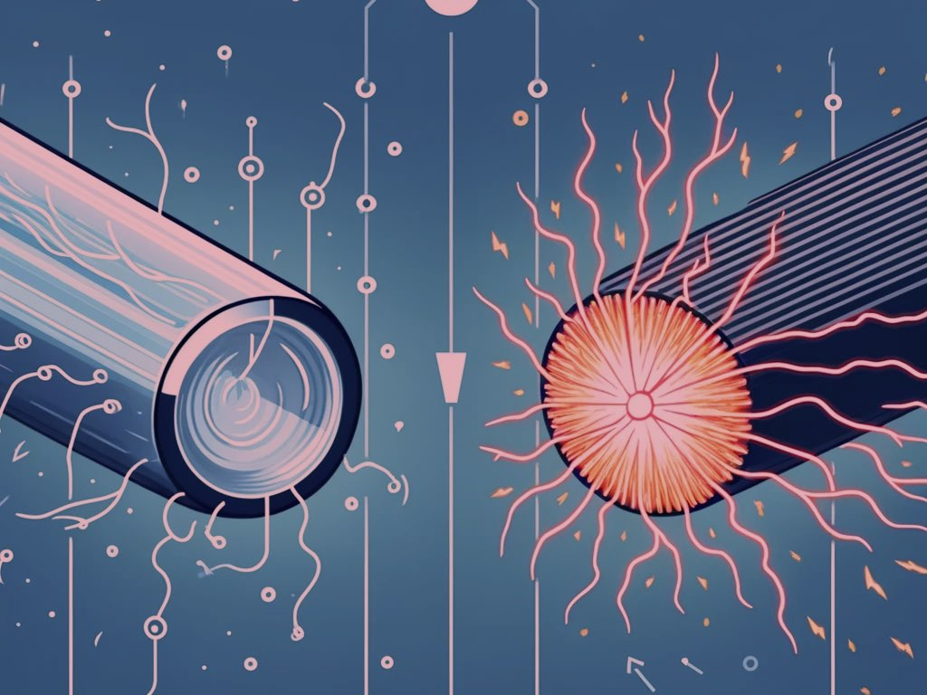
Materials Technology: Superconductivity
Davydov Daniil

Slide 2
Introduction
What is Superconductivity?

Slide 3

Discovery and Types
first discovered in 1911
two main types

Slide 4
Materials and Applications
made from metals, ceramics, and complex compounds
used in MRI machines and maglev trains

Slide 5
Challenges
Most superconductors need very cold temperatures to work

Slide 6
Conclusion
Researchers are working to develop superconductors that can operate at higher temperatures

